Slide 1
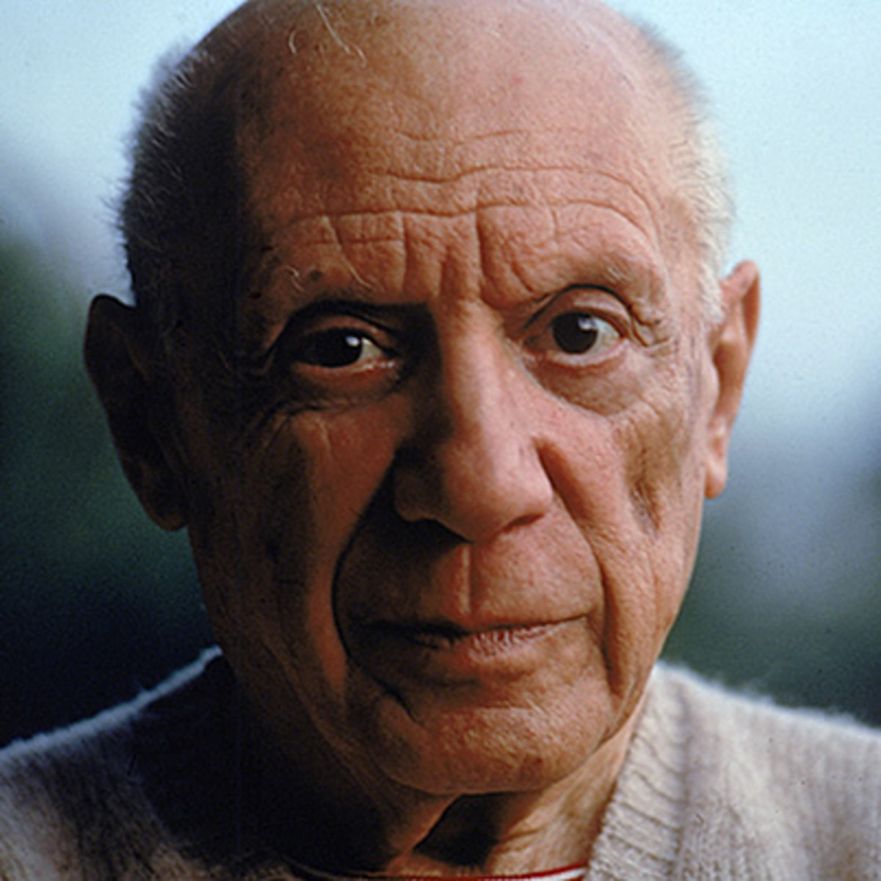
PABLO PICASSO

Slide 2
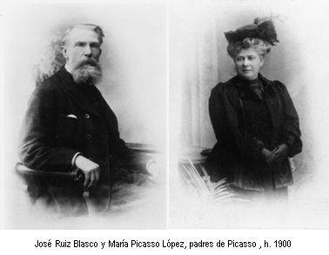
Pablo Diego José Francisco de Paula Juan Nepomuceno María de los Remedios Cipriano de la Santísima Trinidad Ruiz y Picasso
was born the 25th October 1881 in Málaga in the Andalusian region of Spain, he was the first child of Don José Ruiz y Blasco a painter and art teacher and María Picasso y López descent from an italian family .

Slide 3
He was a Spanish painter, sculptor, printmaker, ceramicist, stage designer, poet and playwright who spent most of his adult life in France. Regarded as one of the most influential artists of the 20th century, he is known for co-founding the CUBISM

Slide 4
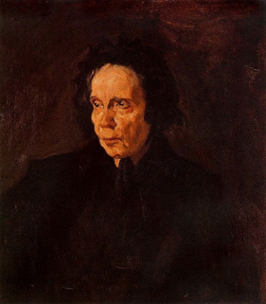
First Period : Realistic style
During the first decade of the 20th century, his style changed as he experimented with different theories, techniques, and ideas. Henri Matisse motivated Picasso to explore more radical styles, beginning a fruitful rivalry between the two artists .He started his first work in a Realistic style at the age of 14
The portrait of aunt PEPA

Slide 5
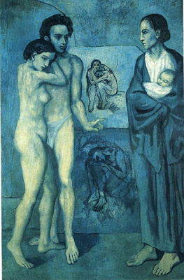
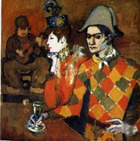
Second Period : Blue and Rose Tones
His realism began to show some Symbolist influences:
The blue period is characterized by the use of blue colour influenced by French impressionist , especially Henri e Toulouse Lautrec.
The Rose Period is characterized by a lighter tone and style utilizing orange and pink colours.
La vie 1903
Au Lapin agile 1905

Slide 6
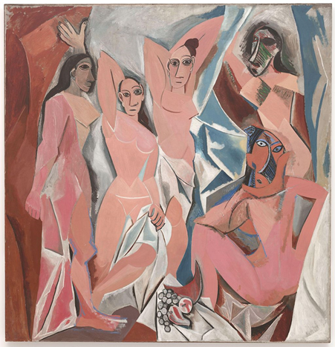
Picasso's African-influenced Period (1907–1909) began with his painting the proto-Cubist period which led directly into the Cubist period that follows: Analytic cubism: 1909–1912:a style of painting Picasso developed with Georges Braque using monochrome brownish and neutral colours. Both artists took apart objects and "analyzed" them in terms of their shapes. Synthetic cubism: 1912–1919 was a further development of the genre of cubism, in which cut paper fragments – often wallpaper or portions of newspaper pages – were pasted into compositions, marking the first use of collage in fine art.
Les Demoiselles d'Avignon.( 1907)

Slide 7
In February 1917, Picasso made his first trip to Italy. In the period following the upheaval of World War I, Picasso produced work in a neoclassical style.
Mother and Child 1921

Slide 8
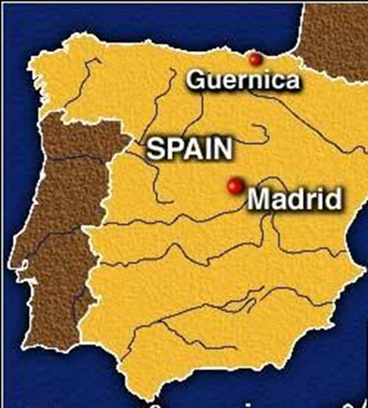
GUERNICA 1937
The period from 1937 to 1939 saw the II World War.
it is called The Great Depression and Guernica (1937), a dramatic portrayal of the bombing of Guernica by the German and Italian airforces represents Picasso's most famous work and his depiction of the German bombing of Guernica during the Spanish Civil War.

Slide 9
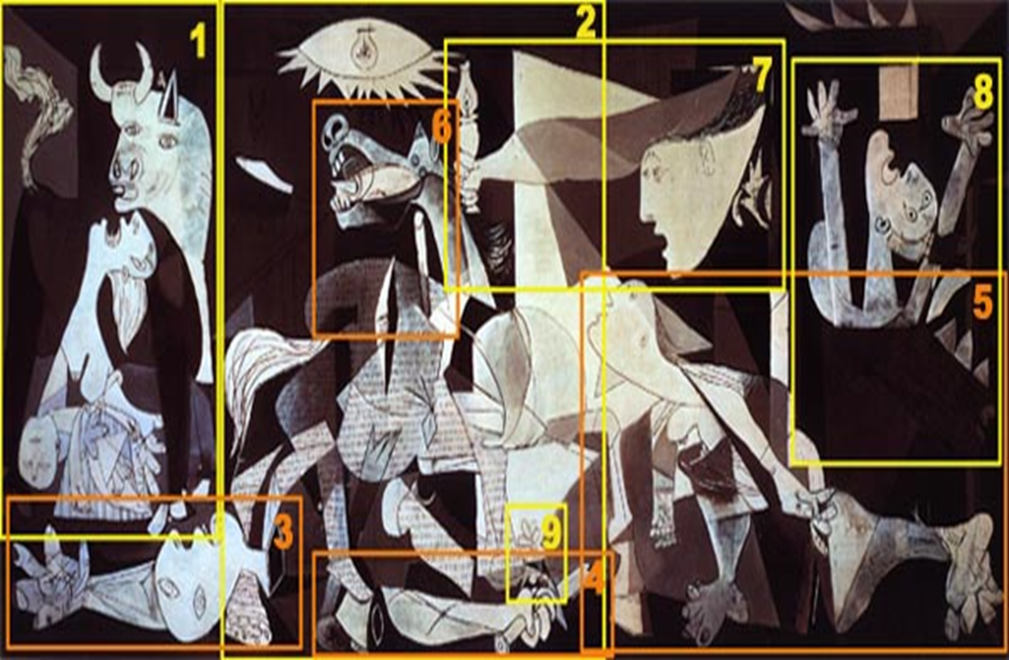
A German officer visited Picasso in his Paris studio during the Second World War. There he saw Guernica and, shocked at the modernist «chaos» of the painting, asked Picasso: «Did you do this?» Picasso calmly replied: «No, you did this!»

Slide 10
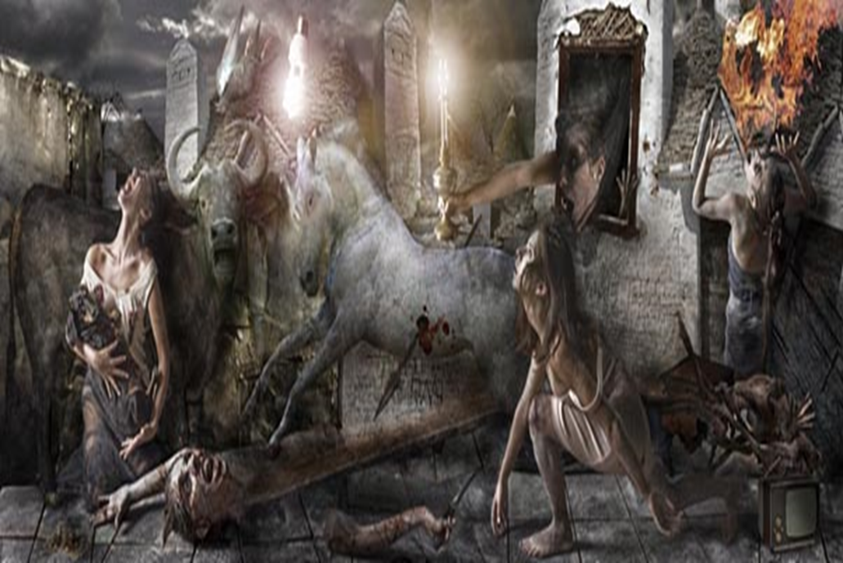
Realistic representation
Guernica is a mural-sized oil painting on canvas completed in June 1937 exhibited at the Paris International Exposition
Standing at 3.50 meters tall and 7.75 meters wide.
the large mural shows the suffering of people wrenched by violence and chaos after the bombing of Guernica
The artist uses a palette of gray, black, and white to internalize the horror of the war

Slide 11
Human figures: 1 -on the left of the picture a woman with a dead child in her arms . This couple is just below the bull, almost as if protected by him, looking towards the sky and with a scream of pain. The woman has a sharp tongue and her eyes in the form of tears. She holds her dead son who has no pupils for not having life. This image of mother-child is the usual representation in the Christian art of the Virgin Mary with her dead son as in Pieta. 2 -a dismembered warrior with a broken sword in her hand .The only thing that can be observed are remains of the head, a full arm or right and left forearm. An arm holding a broken sword and a flower as a symbol of a ray of hope within that terrible scene. 3 on the right, a woman who burns in the flames, 4 another woman who fled in terror from the fire 5 a third that goes out the window with a lamp in his hand.
Animal figures:
6 a strong bull that looks defiantly at the scene, the bull meant brutality and darkness. The artist loved the traditional Spanish custom of bullfighting
7 a horse with a spear stuck on the verge of death, symbolized the dead people.
8a pigeon with a broken wing and an open beak. the dove is a symbol of broken peace
9The Light bulb symbolizes scientific and electronic progress in a form of social advancement. Picasso also wanted to symbolize the light bulb as the God who sees everything.
The nine figures evoke the same: pain, death, fear, destruction, anger and rebellion, the cry and also hope.

Slide 12
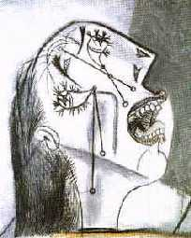
In documenting the terrible consequences in Guernica , Picasso said
” I clearly express my abhorrence of the military caste which has sunk Spain in an ocean of pain and death. Painting is not made to decorate apartments. It's an offensive and defensive weapon against the enemy"
The crying woman

Slide 13
CLIL: content language integrated learning Cubism/ Picasso/ Guernica
Art Teacher : Natalino Guastella
English Teacher : Corradina Malgozzi
VF Liceo Scientifico 2017/18

